Slide 1


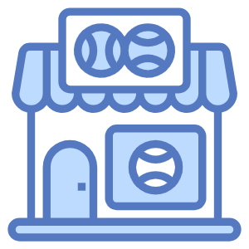
EASY SHOP
MARKETING PERFORMANCE
& CUSTOMER ENGAGEMENT ANALYSIS

Slide 2


SUMMARY
1
OVERVIEW
2
DECREASED CONVERSION RATES
3
REDUCED CUSTOMER ENGAGEMENT
4
CUSTOMER FEEDBACK ANALYSIS
5
GOALS & ACTIONS

Slide 3
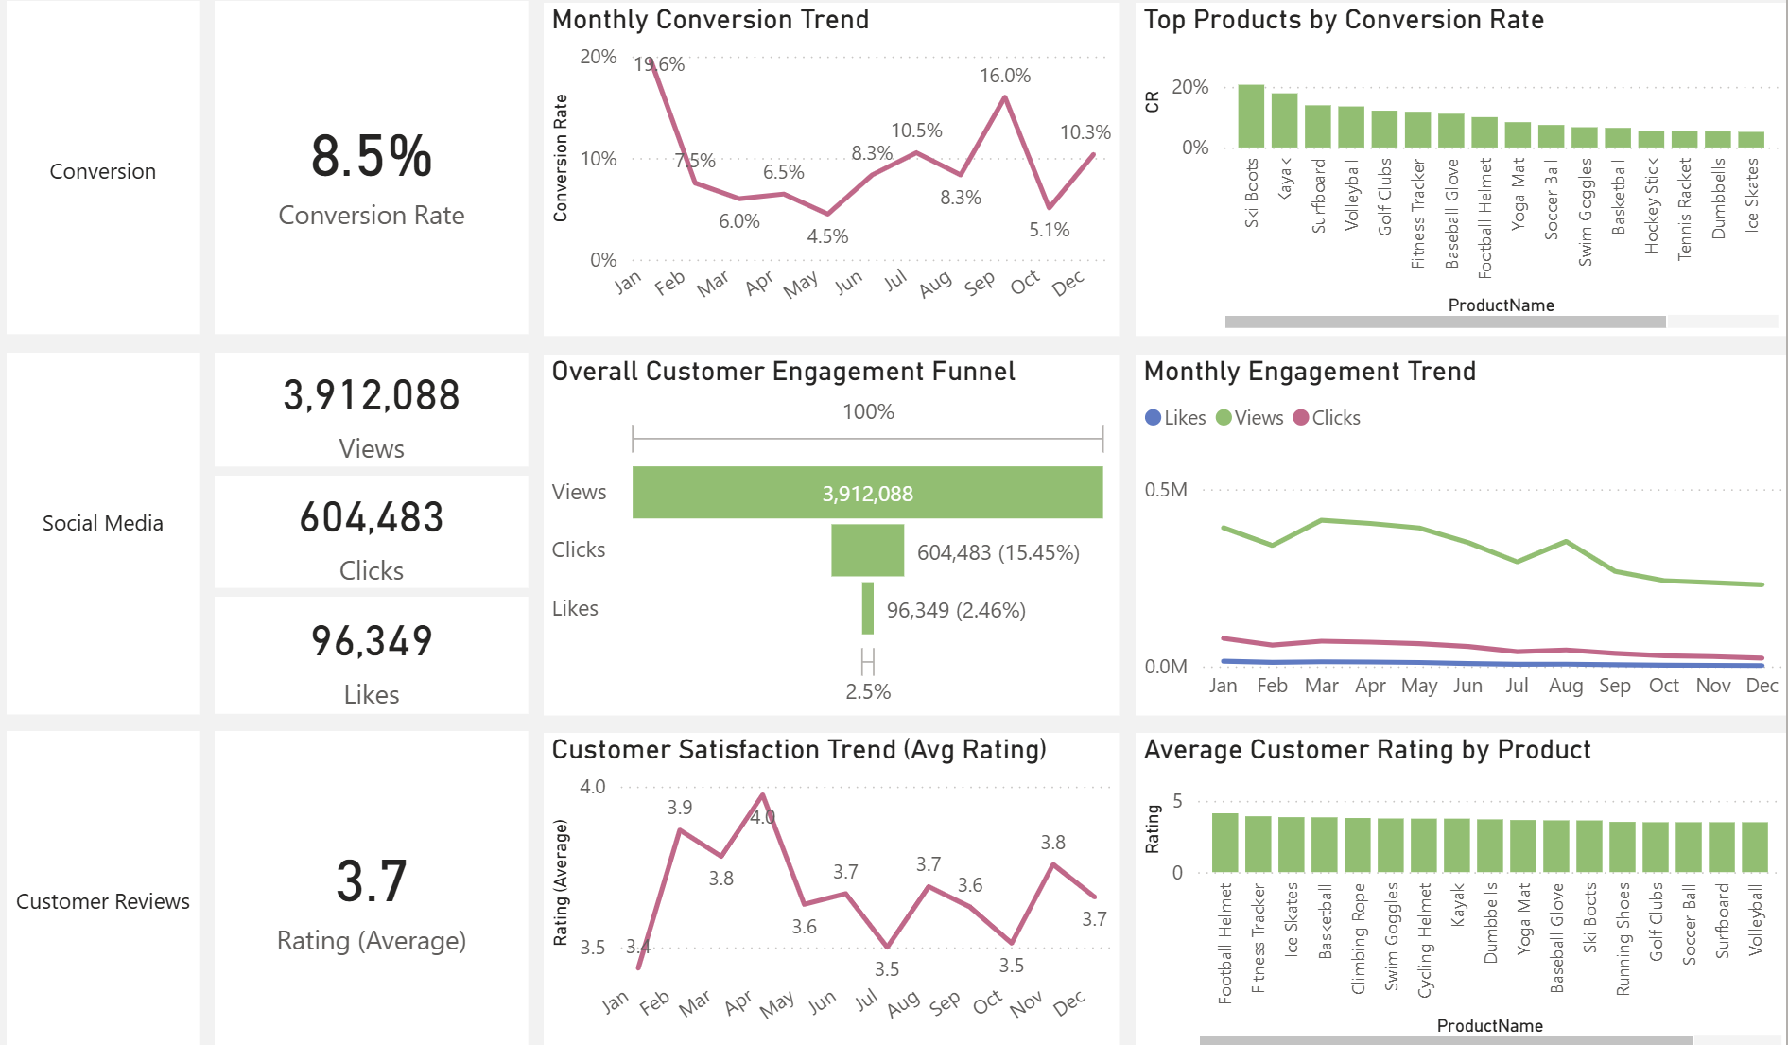
1. OVERVIEW
Decreased Conversion Rates:
The conversion rate demonstrated a strong rebound in December, reaching 10.3%, despite a notable dip to 5.1% in October.

Slide 4
1. OVERVIEW
Reduced Customer Engagement:
There is a decline in overall social media engagement, with views dropping throughout the year.
While clicks and likes are low compared to views, the click-through rate stands at 15.45%, meaning that engaged users are still interacting effectively.

Slide 5
1. OVERVIEW
Customer Feedback Analysis:
Customer ratings have remained consistent, averaging around 3.7 throughout the year.
Although stable, the average rating is below the target of 4.0, suggesting a need for focused improvements in customer satisfaction, for products below 3.5.

Slide 6
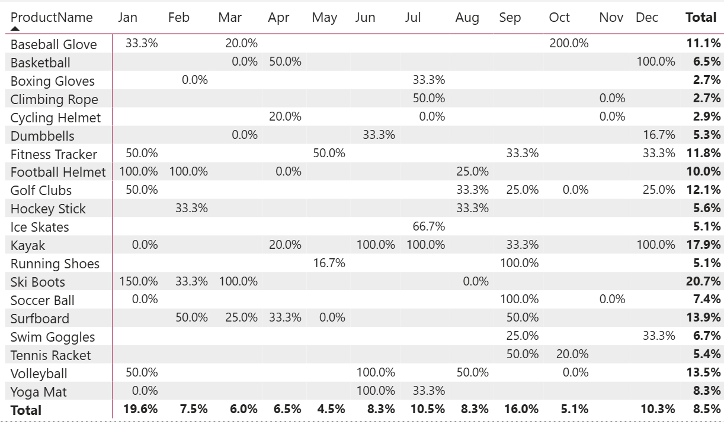
2. DECREASED CONVERSION RATES
General Conversion Trend:
Conversion rates fluctuated throughout the year.
Higher conversion performance was observed in February and July.
Some products showed clear seasonal peaks.
Lower-performing months present opportunities for improvement through targeted marketing actions.

Slide 7
2. DECREASED CONVERSION RATES
Lowest Conversion Month:
May experienced the lowest overall conversion rate at 4.5%, with no products standing out significantly in terms of conversion. This indicates a potential need to revisit marketing strategies or promotions during this period to boost performance.

Slide 8
2. DECREASED CONVERSION RATES
Highest Conversion Rates:
January recorded the highest overall conversion rate at 19.6%, driven significantly by the Ski Boots with a remarkable 150% conversion. This indicates a strong start to the year, likely fueled by seasonal demand and effective marketing strategies.

Slide 9
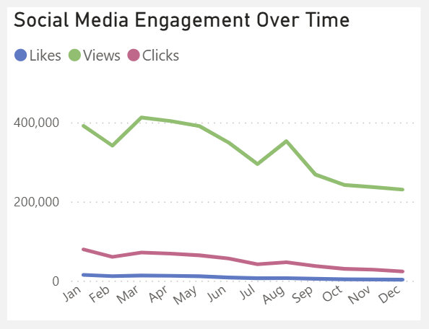
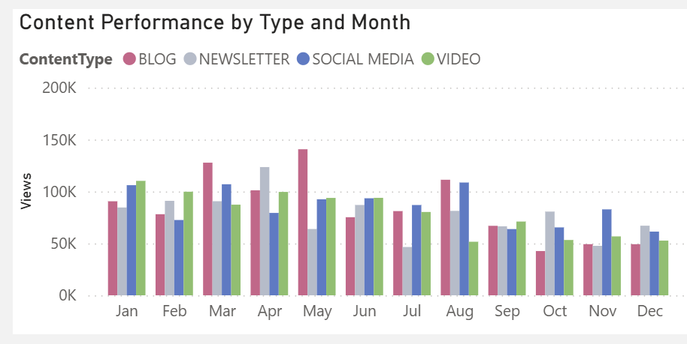
3. REDUCED CUSTOMER ENGAGEMENT
Declining Views:
  Overall content views peaked in the first half of the year, particularly around March–May, before gradually declining from August onward, indicating reduced audience engagement in the later months.
Low Interaction Rates:
  Clicks and likes remained consistently low compared to views, suggesting the need for more engaging content or stronger calls to action.
Content Type Performance:
  Blog and newsletter content generated the highest views, especially in March - May, whereas social media and video content showed more stable but comparatively lower engagement throughout the year.

Slide 10
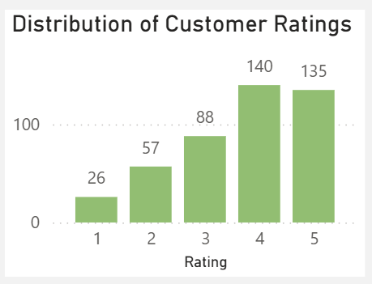
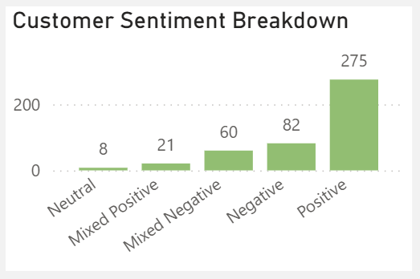
4. CUSTOMER FEEDBACK ANALYSIS
Customer Ratings Distribution:
  The majority of customer reviews are in the higher ratings, with 140 reviews at 4 stars and 135 reviews at 5 stars, indicating overall positive feedback. Lower ratings (1-2 stars) account for a smaller proportion, with 26 reviews at 1 star and 57 reviews at 2 stars.
Sentiment Analysis:
  Positive sentiment dominates with 275 reviews, reflecting a generally satisfied customer base. Negative sentiment is present in 82 reviews, with a smaller number of mixed and neutral sentiments, suggesting some areas for improvement but overall strong customer approval.

Slide 11
4. CUSTOMER FEEDBACK ANALYSIS
Opportunity for Improvement:
  The presence of mixed positive and mixed negative sentiments suggests that there are opportunities to convert those mixed experiences into more clearly positive ones, potentially boosting overall ratings. Addressing the specific concerns in mixed reviews could elevate customer satisfaction.

Slide 12
5. GOALS & ACTIONS
GOALS
Increase Conversion Rates:
  Goal: Identify factors impacting the conversion rate and provide recommendations to improve it.
  Insight: Highlight key stages where visitors drop off and suggest improvements to optimize the conversion funnel.
Enhance Customer Engagement:
  Goal: Determine which types of content drive the highest engagement.
  Insight: Analyze interaction levels with different types of marketing content to inform better content strategies.
Improve Customer Feedback Scores:
  Goal: Understand common themes in customer reviews and provide actionable insights.
  Insight: Identify recurring positive and negative feedback to guide product and service improvements.

Slide 13
5. GOALS & ACTIONS
ACTIONS
Increase Conversion Rates:
  Prioritize high-performing products such as Kayaks, Ski Boots, and Baseball Gloves, and leverage seasonal and personalized campaigns during peak months to maximize conversions.
Enhance Customer Engagement:
  Refresh content strategy by adopting more interactive formats and improving call-to-action effectiveness, especially during lower-engagement periods toward the end of the year.
Improve Customer Feedback Scores:
  Analyze mixed and negative reviews to identify recurring issues, implement targeted improvements, and proactively engage dissatisfied customers to raise average ratings toward the 4.0 target.

Slide 14


THANK
YOU!

